Slide 1
Chapter 2:
Processes for the continuity of life
Created by CENGAGE Learning
Edited by Ms Rayner, 2022

Slide 2
Continuity of life requires the replication of genetic material and its transfer to the next generation.
Describe the following processes and how they transfer genetic material to the next generation:
binary fission, mitosis, meiosis and fertilisation
Syllabus:
Essential
Question:

Slide 3
What you need to complete
Read Chapter 2 Biology WA ATAR Units 3 & 4
Answer Biology WA ATAR Question Sets
    Set 2.1 pg. 30-31 Q 1 – 8
    Set 2.2a pg. 32 Q 1 – 3
    Set 2.2b pg. 37 Q 1 – 7
    Set 2.2c pg. 38 Q 1 – 3
    Set 2.2d pg. 42 Q 1 – 7
    Set 2.3 pg. 44 Q 1 a & b, 2 – 4 & 6
    NOTE: Some of these question have been used in this PPT and the note taking scaffold
Biozone Activities
    115
    116
    132
    133
    136
    138
    139

Slide 4
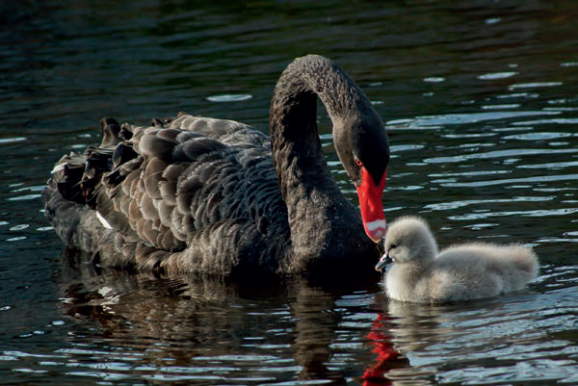
Topic Question 1: Define the term heredity and give an example
Heredity
Heredity is the study of inheritance and of the processes involved in transmitting genetic material to the next generation of cells or offspring.
Shutterstock.com/Jessica Dale

Slide 5
Topic Question 2: Explain what DNA is and how it determines the characteristics of offspring
DNA
DNA (deoxyribonucleic acid)
Is the genetic material that is passed on to offspring for the continuity of life.
Determines the characteristics that define the species.
In all living things
Contains the instructions, written in a chemical code, for the production of proteins by the cell
The information it contains is sufficient for the making and maintaining of an organism.

Slide 6
Topic Question 3: Compare how DNA is packaged in Eukaryotic & Prokaryotic Cells
Chromosomes of eukaryotes
A tightly coiled and condensed human chromosome (only visible during cell division and when stained)
A nucleosome consists of a section of a DNA molecule looped twice around a core of eight histone proteins.
Interacting proteins package loops of coiled DNA, called chromatin, which is organised as a cylindrical fibre.
Chromatin is further condensed to make chromosomes.

Slide 7
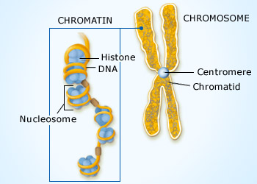
Topic Question 3: Compare how DNA is packaged in Eukaryotic & Prokaryotic Cells
Closer look at a Chromosome

Slide 8
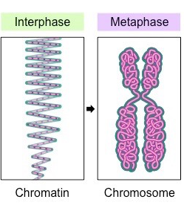
Topic Question 3: Compare how DNA is packaged in Eukaryotic & Prokaryotic Cells

Slide 9
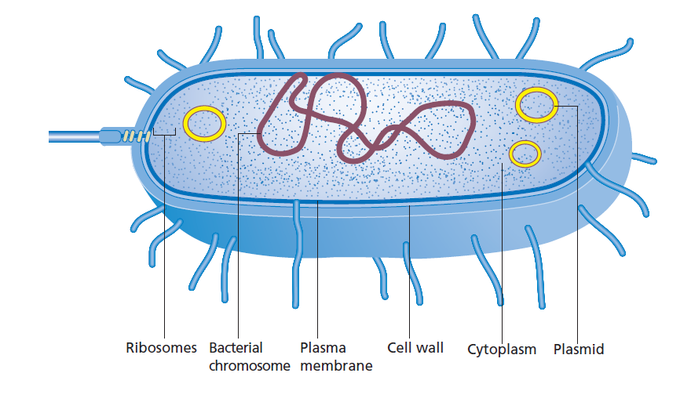
Topic Question 3: Compare how DNA is packaged in Eukaryotic & Prokaryotic Cells
Chromosomes of prokaryotes

Slide 10
YR 11 RECAP: Comparing eukaryotes and prokaryotes
Factor | Prokaryotic cell | Eukaryotic cell
Typical diameter | 1−5 micrometres | 10−100 micrometres
Location of DNA | In cytoplasm (in nucleoid) | In nucleus
Membrane-bound organelles | No membrane-bound organelles (such as mitochondria, endoplasmic reticulum, Golgi apparatus, or nucleus) | Membrane-bound organelles, including a nucleus
Ribosomes | Yes, but they float freely in the cytosol | Yes, they can float freely in the cytosol or be attached to the endoplasmic reticulum
Chromosome(s) | A single circular DNA strand (typically, without histones) | DNA is wrapped around proteins (called histones), creating units called nucleosomes. This loosely coiled form of DNA is called chromatin. The chromatin coils more tightly (‘condenses’) to form chromosomes in preparation for mitosis or meiosis.

Slide 11
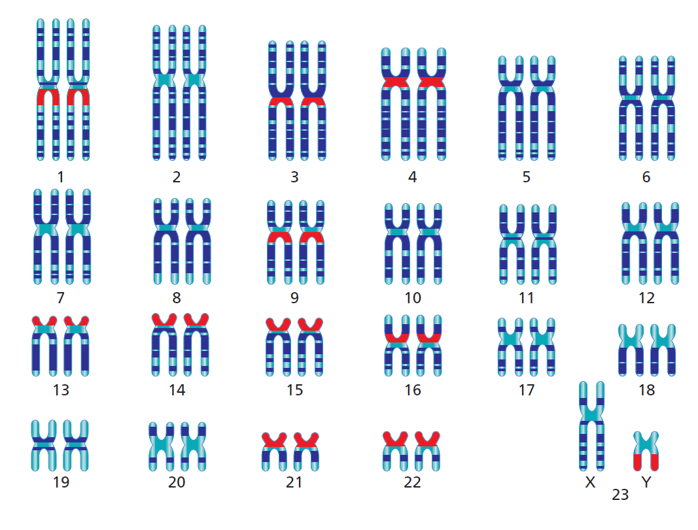
Topic Question 4: Describe how a Karyotype is created and what it can reveal about the genetics of an individual
Chromosomes of eukaryotes - karyotype
When chromosomes are paired and ordered they can be shown as a karyotype, the standard graphical form used to display and analyse chromosomes.
Paired based on size, banding pattern and location of the centromere
Each pair of chromosomes contains one paternal and one maternal chromosome.
Matched pairs of non-sex chromosomes are called autosomes and are homologous.
One pair of chromosomes is the sex chromosomes (allosomes)

Slide 12
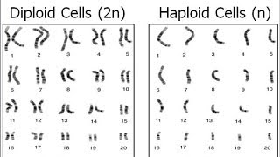
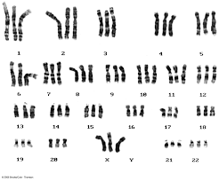
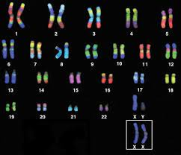

Slide 13
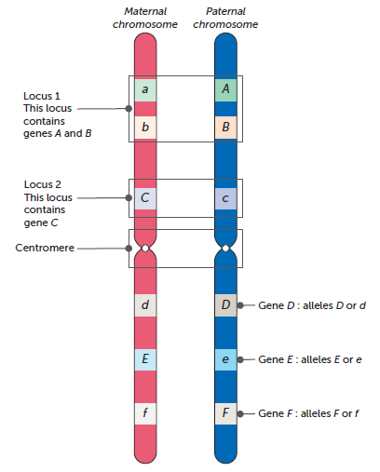
Topic Question 5: Label the Locus, Gene and Allele of a Chromosome & define these terms
Chromosomes of eukaryotes
This is a diagram showing homologous chromosomes.
This means the chromosomes have the same number of genes, but they have different alleles for
each trait as they come from two different parents. One of the homologous chromosomes is
from the mother (maternal) and the other from the father (paternal).
They are not sex chromosomes and so are called autosomes

Slide 14
Topic Question 5: Label the Locus, Gene and Allele of a Chromosome & define these terms
A locus is the position of a gene, a cluster of genes or even a single nucleotide on a chromosome.
Gene is a region of DNA that code for specific proteins
Alternative forms of the same gene are called alleles, and can be given names such as D and d depending on the allele’s characteristics.

Slide 15
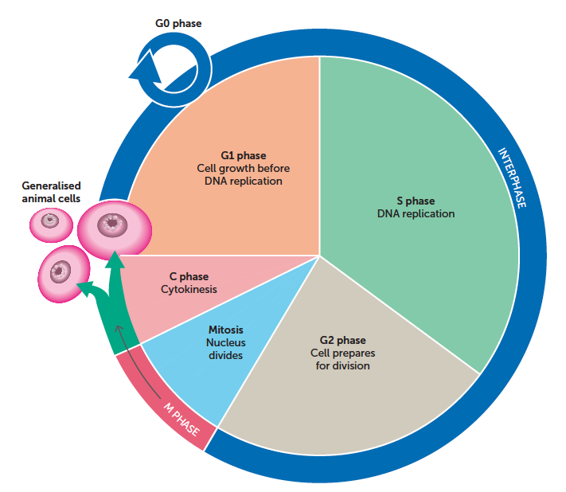
Topic Question 6: Add the six phases to your cell cycle and define each phase
Cell division
The sequence of events from one cell division to another is called the cell cycle.
Duplication of chromosomes & centromeres
Further growth & reproduction of organelles

Slide 16
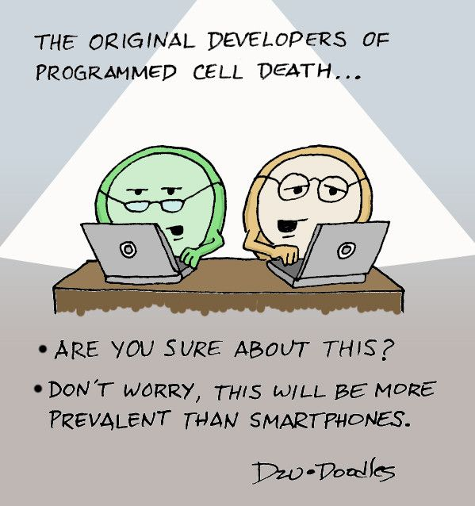
Topic Question 7: Explain when the process of apoptosis can be beneficial
Cells do not live forever and continue the cell cycle indefinitely
Pre-programmed to age & die
Apoptosis is the name given to the process of cell death
Think of some examples where apoptosis occurs in living organisms

Slide 17
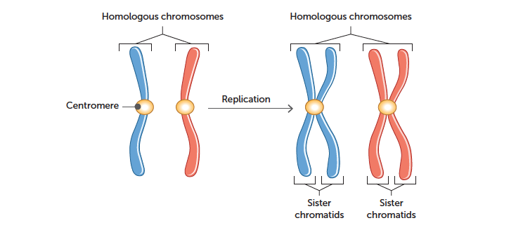
Cell division
Topic Question 8: Draw a labelled diagram to describing what occurs during interphase
Prior to any cell division, a doubling of the genetic material needs to take place. This happens during interphase.
Chromatid
Paternal Chromosome
Maternal Chromosome

Slide 18
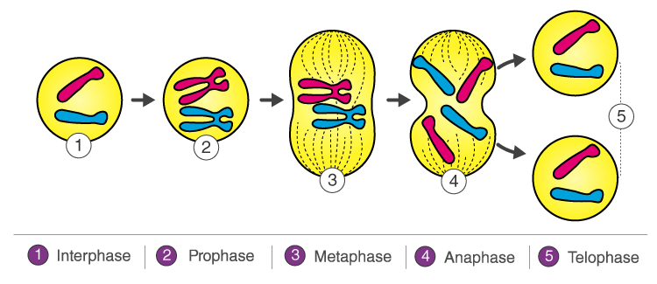
Topic Question 9: Define the terms Mitosis and state the purpose of this type of nuclear division
Cell division of Eukaryotic Cells
Mitosis
Occurs only in eukaryotic cells
A type of nuclear division occurring in somatic cells
Maintains the parental diploid number of chromosomes in the daughter cells
Daughter cells are identical to parental cells
bodily growth
Repair
Asexual reproduction.

Slide 19
Cell division − Mitosis
Topic Question 10: Draw labelled diagrams describing what occurs at each phase of mitosis
Mitosis, a relatively short part of the cell cycle, is itself broken down into four phases: prophase, metaphase, anaphase and telophase.
For the completion of cell division, cytokinesis, division of the cytoplasm, follows mitosis (nuclear division).
Mitosis produces two separate, identical, diploid daughter cells.
I . P . M . A . T

Slide 20
Prophase
Mitosis
Chromatin threads condense to form chromosomes.
Nuclear membrane disintegrates and nucleolus disappears.
Mitotic spindle begins to form and is completed by the end of prophase.
Spindle fibres attach to each chromosome at its centromere.
The two centrosomes (each containing two centrioles) move toward opposite poles of the cell.
NOTE Plant cells do not have centrosomes or centrioles
REMEMBER – A Chromosome consists of 2 sister chromatids held together by a centromere

Slide 21
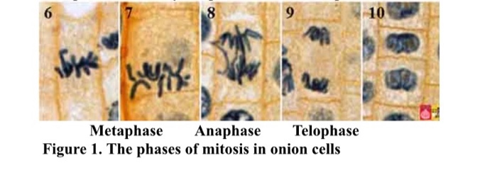
Metaphase, Anaphase & Telophase

Slide 22
Metaphase
Mitosis
Chromosomes move to centre of cell and line up along the equator (also referred to as the metaphase plate).
Centromeres of the chromosomes are aligned on equator and are attached to the spindle fibres
The centrioles are located at opposite poles of the cell.

Slide 23
Anaphase
Mitosis
Spindle microtubules shorten and pull on the centromere; sister chromatids separate.
Spindle microtubules pull sister chromatids to opposite poles of cell.
At end of phase, each pole has a complete identical set of maternal and paternal chromosomes.
Sister chromatids now referred to as chromosomes.

Slide 24
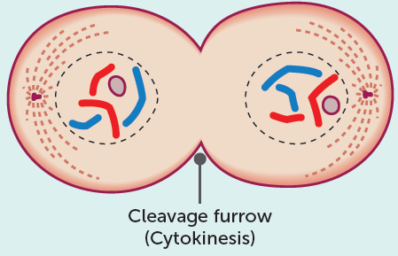
Telophase
Mitosis
Chromosomes decondense to form chromatin; can no longer be seen under microscope.
Two new nuclear membranes form, one for each new daughter cell.
Nucleoli reappear and spindle apparatus disappears.
Cell elongates to become ready for cytokinesis.

Slide 25
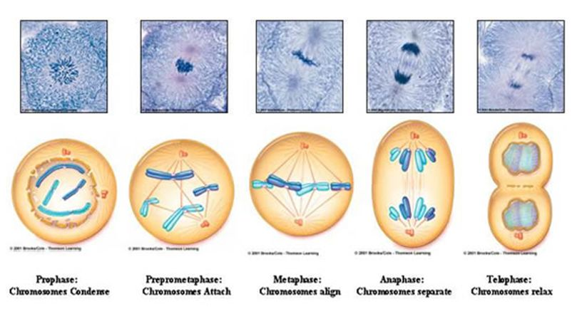
WATCH: https://www.youtube.com/watch?v=f-ldPgEfAHI&t=335s

Slide 26
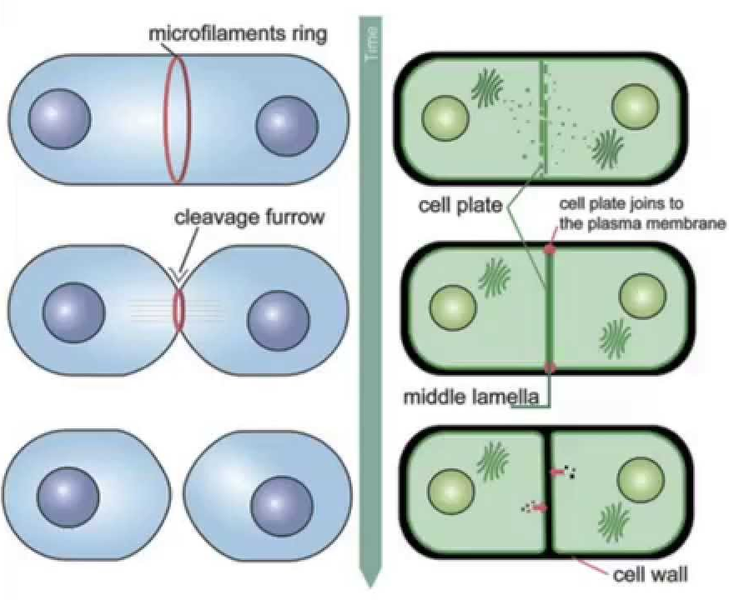
Topic Question 11: Define the term cytokinesis and explain how this process occurs in plant and animal cells
Read about Cytokinesis in plant cells and animal cells (page 35-36) and take notes detailing how cytokinesis occurs in each cell type

Slide 27
Topic Question 12: Draw labelled diagrams and describe how prokaryotic cells divide
1 Prior to binary fission, single chromosome is tightly coiled.
2 Genetic material in the chromosome and the plasmid replicates and separates. Each copy of DNA then attaches to a different part of the cell membrane.
3 Original and replicate chromosomes attach to cell membrane; are pulled to separate poles as cell elongates.
4 New cell wall starts to grow; cleavage furrow develops in cell membrane.
New cell wall fully develops.
6 Two cells separate, forming two identical daughter cells: cytokinesis. Chromosomes become tightly coiled again.

Slide 28
Cell division − Binary fission
Topic Question 13: Compare Binary Fission and Mitosis
As prokaryotes lack a nucleus and have only a single chromosome with no centromere, they cannot be properly said to undergo mitosis. They reproduce
by binary fission.
Binary fission can be defined as a process of asexual reproduction whereby
a prokaryotic cell divides into two identical daughter cells.
The process includes DNA replication, chromosome segregation, and cytokinesis (not all these are included within the process of Mitosis)
There is limited variation in prokaryotic populations other than that due to mutation.
However, binary fission is a process that happens relatively fast compared with other cell division processes, which means the mutation rate is much higher.

